Slide 1
Text-to-Image conversion using diffusion models
Rajandeep Singh (B20CS049)
Bhuminjay Soni(B20CS009)

Slide 2
Problem Formulation
Since the start of the Silicon Age , there has been an increased trend to automate the tedious tasks of day-to-day life
Small things like the automatic doors at supermarkets to Self-driving electric vehicles are the result of automation
This sudden and uprising urge of automate things took us to the domain of art and visualization
Using the power of AI to quickly turn our thoughts or imagination to real images just by entering our text
Getting any image we want , in any format just a few clicks away

Slide 3
Adopted Solution
Use of Text-to-Image Diffusion models to convert text prompt into a image which matches the user’s requirement
There are various ML models which make use of Diffusion models for conversion from text to images like DALL-E and Imagen
The model that we work on is a mini version of DALL-E which strips the bells and whistles of the very powerful and resource hungry DALL-E into a more light weight version

Slide 4
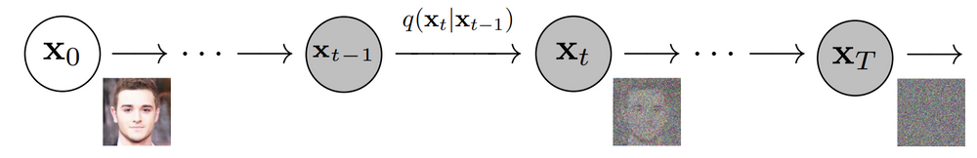
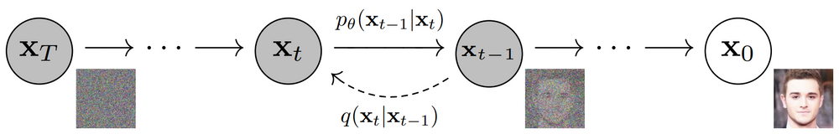
Diffusion Models
Diffusion Models are a subclass of generative models, which are used to produce new data, frequently pictorial data
Diffusion models are trained by introducing Gaussian noise to training pictures over a number of timesteps
After that Diffusion models learn how to remove that noise to generate new images
Learning to reverse the forward process can be reduced to learning to denoise the created noisy image into an estimation of the original data

Slide 5
DALL-E Architecture
DALLE uses an OpenAI model called CLIP(Contrastive Language-Image Pre-training) to link the textual semantics to the image.CLIP is trained on a large dataset of text and image pairs , it maps the image and its associated captions to a higher dimensional space.
DALLE now freezes the CLIP model & reverses the image-caption encoding of CLIP learned previously.The connection between captions and visual encodings is easier to understand in a higher dimensional space.
To perform the semantically correct image generation from visual encodings DALLE uses another model called GLIDE(Guided Language-to-Image Diffusion for Generation and Editing).

Slide 6
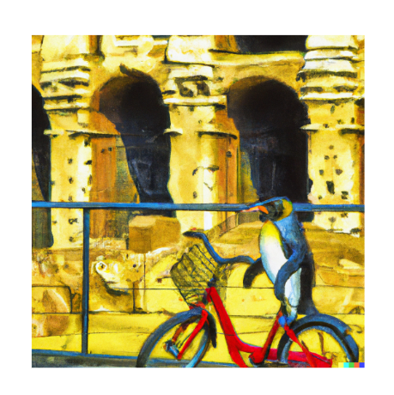
DALL-E Architecture
To connect the textual semantics to visual semantics DALLE uses a model called “prior” which is Diffusion model, that connects the textual encodings of image captions to image encodings of the semantically related output image.
Converts the text description into tokens which then maps the CLIP text encoding of these tokens to a semantically related CLIP image encoding.
A Penguin riding bicycle at the coliseum of rome, Digital art oil painting

Slide 7
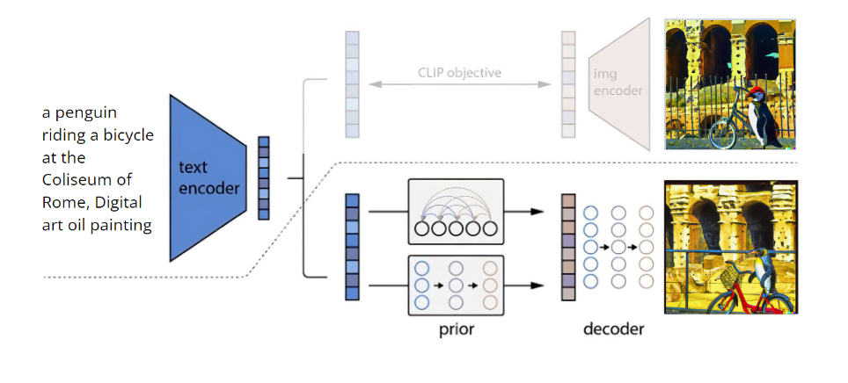
Working of DALL-E

Slide 8
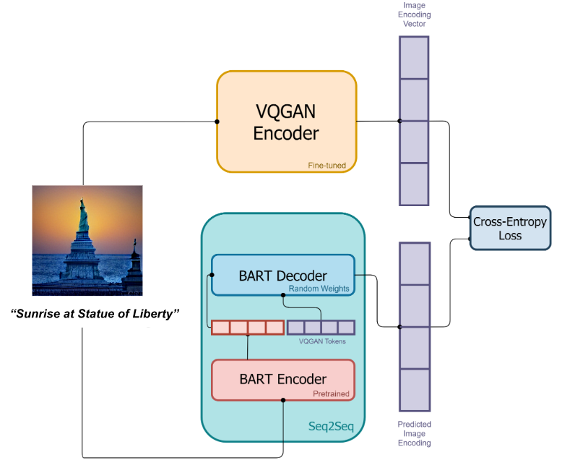
DALL-E Mini Architecture
Datasets used : Conceptual Captions , Conceptual 12M
VQGAN as the Image encoder
BART encoder as the text encoder
BART decoder as the image decoder
Data fed for training is image-caption pairs
VQGAN converts the input image into a higher dimensional image encoding tokens
BART Encoder converts the text prompt into tokens which are then used by BART Decoder to create new image encodings
The loss is calculated through the cross-entropy function

Slide 9
DALL-E Mini Architecture
The text prompt is encoded by BART encoder into tokens
BART Decoder convert the above tokens into image encodings
VQGAN Decoder converts the image encodings into actual images
CLIP is used to rank the images based on the cosine similarity between text prompt and the generated images

Slide 10
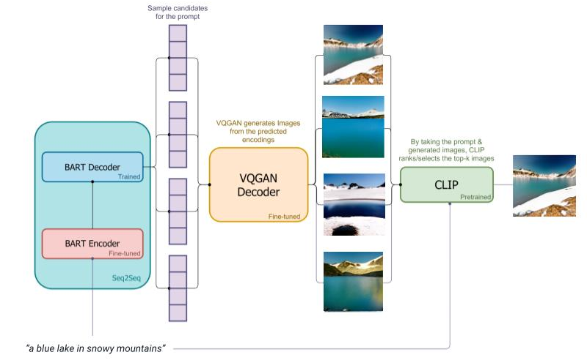
Working of DALL-E Mini

Slide 11
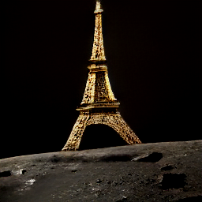
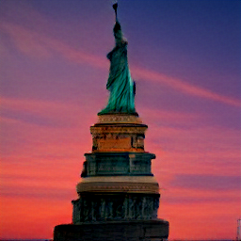
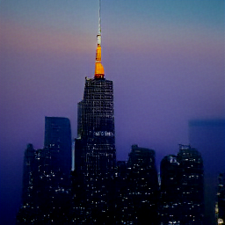
Results on Custom Inputs
“Eiffel tower at moon”
“Sunset at the Statue Of Liberty”
“Sunrise view from the Empire State building”

Slide 12
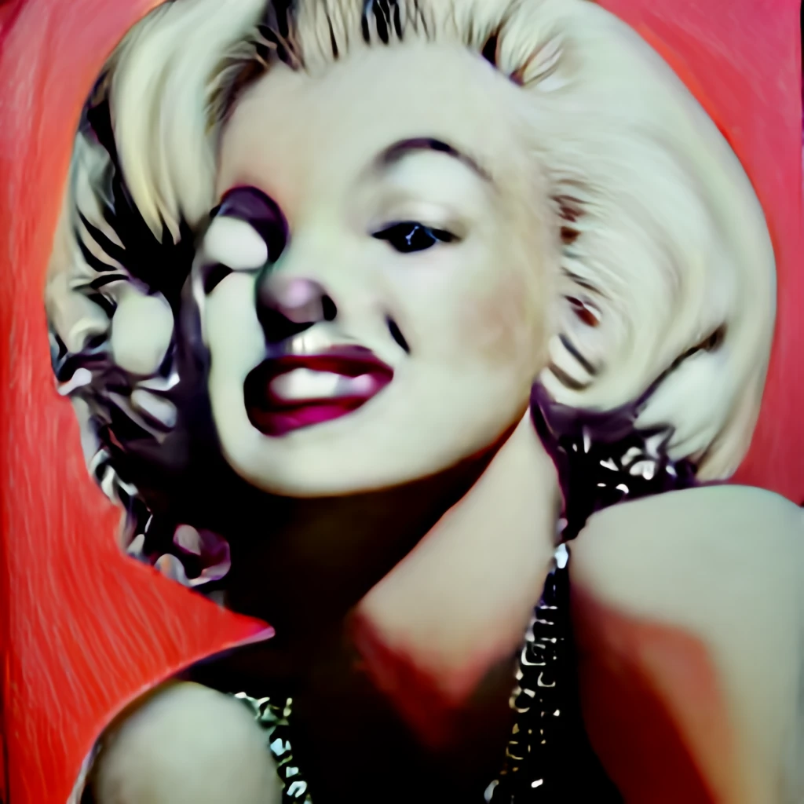
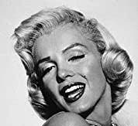
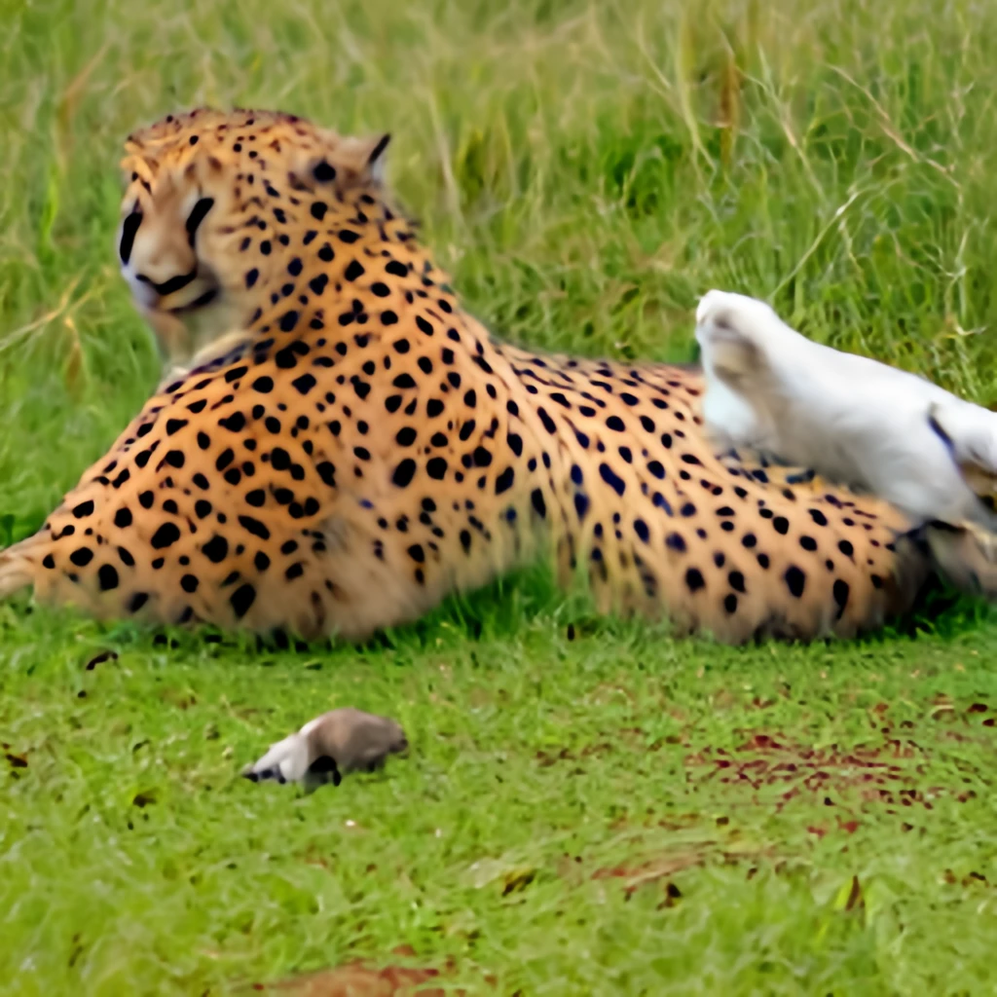
Limitations
Human Face
Animals
Output for “Oil Painting of Marilyn Monroe”(left) versus the actual portrait of Marilyn Monroe(right)
“A cheetah and rabbit playing together”

Slide 13
References and Resources
https://arxiv.org/abs/1910.13461
https://medium.com/nightcafe-creator/vqgan-clip-tutorial-a411402cf3ad
https://arxiv.org/pdf/2205.11487.pdf
https://openai.com/blog/clip/

